Slide 1
The impact of need for closure on model-supported group conflict management
Etiënne Rouwette, Radboud University Nijmegen, The Netherlands
L. Alberto Franco, Loughborough University, UK
Hubert Korzilius, Radboud University Nijmegen, The Netherlands

Slide 2
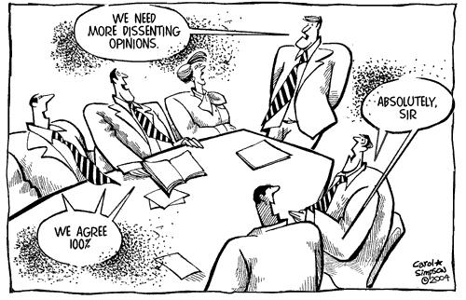
Motivation
Need for closure (NFC), the desire for definite knowledge on some issue, has important consequences for decision making
Individuals high in NFC tend to seize and freeze on information
This tendency has been demonstrated for both individuals and groups
NFC is an individual trait but can also arise from context
NFC can have significant implications for model-supported processes

Slide 3
Research questions and conceptual model
Need for
closure
Model-supported
conflict management
Quality of
group outcomes
How does NFC influence conflict management in a model-supported group process?
How does NFC influence quality of group outcomes?
How does conflict management influence the relation between NFC and quality of group outcomes?

Slide 4
Subjects, manipulation and task
Participants were MSc and MBA students at UK & Dutch universities
Task is part of course work
Groups with a past and a future of working together
Need for closure as personal tendency
Two weeks prior to experiment participants completed NFC scale (Webster and Kruglanski, 1994)
92 participants scoring below median of scale placed in 19 low NFC groups
91 participants scoring above median of scale placed in 21 high NFC groups
Participants worked on the Foundation task (Watson, 1988)
Aim is to divide an amount of money over six projects requesting funds from a philanthropic foundation
Each project represents a basic human value, such as aesthetics (purchase objects for the art gallery) or equality (establish an additional shelter for the homeless)

Slide 5
Model-based support
Participants used Value Focused Thinking approach (Keeney, 1992; 1996):
Asks participants to voice concerns (e.g. issues, interests, objectives)
Based on the assumption that decisions should be made on the basis of fundamental objectives
Main output is a set of linked objectives that guide value-driven group discussions
All groups received training and a written procedure to follow (self-facilitated)
Groups had 3, 4 or 5 members
Groups had one hour to complete their task

Slide 6
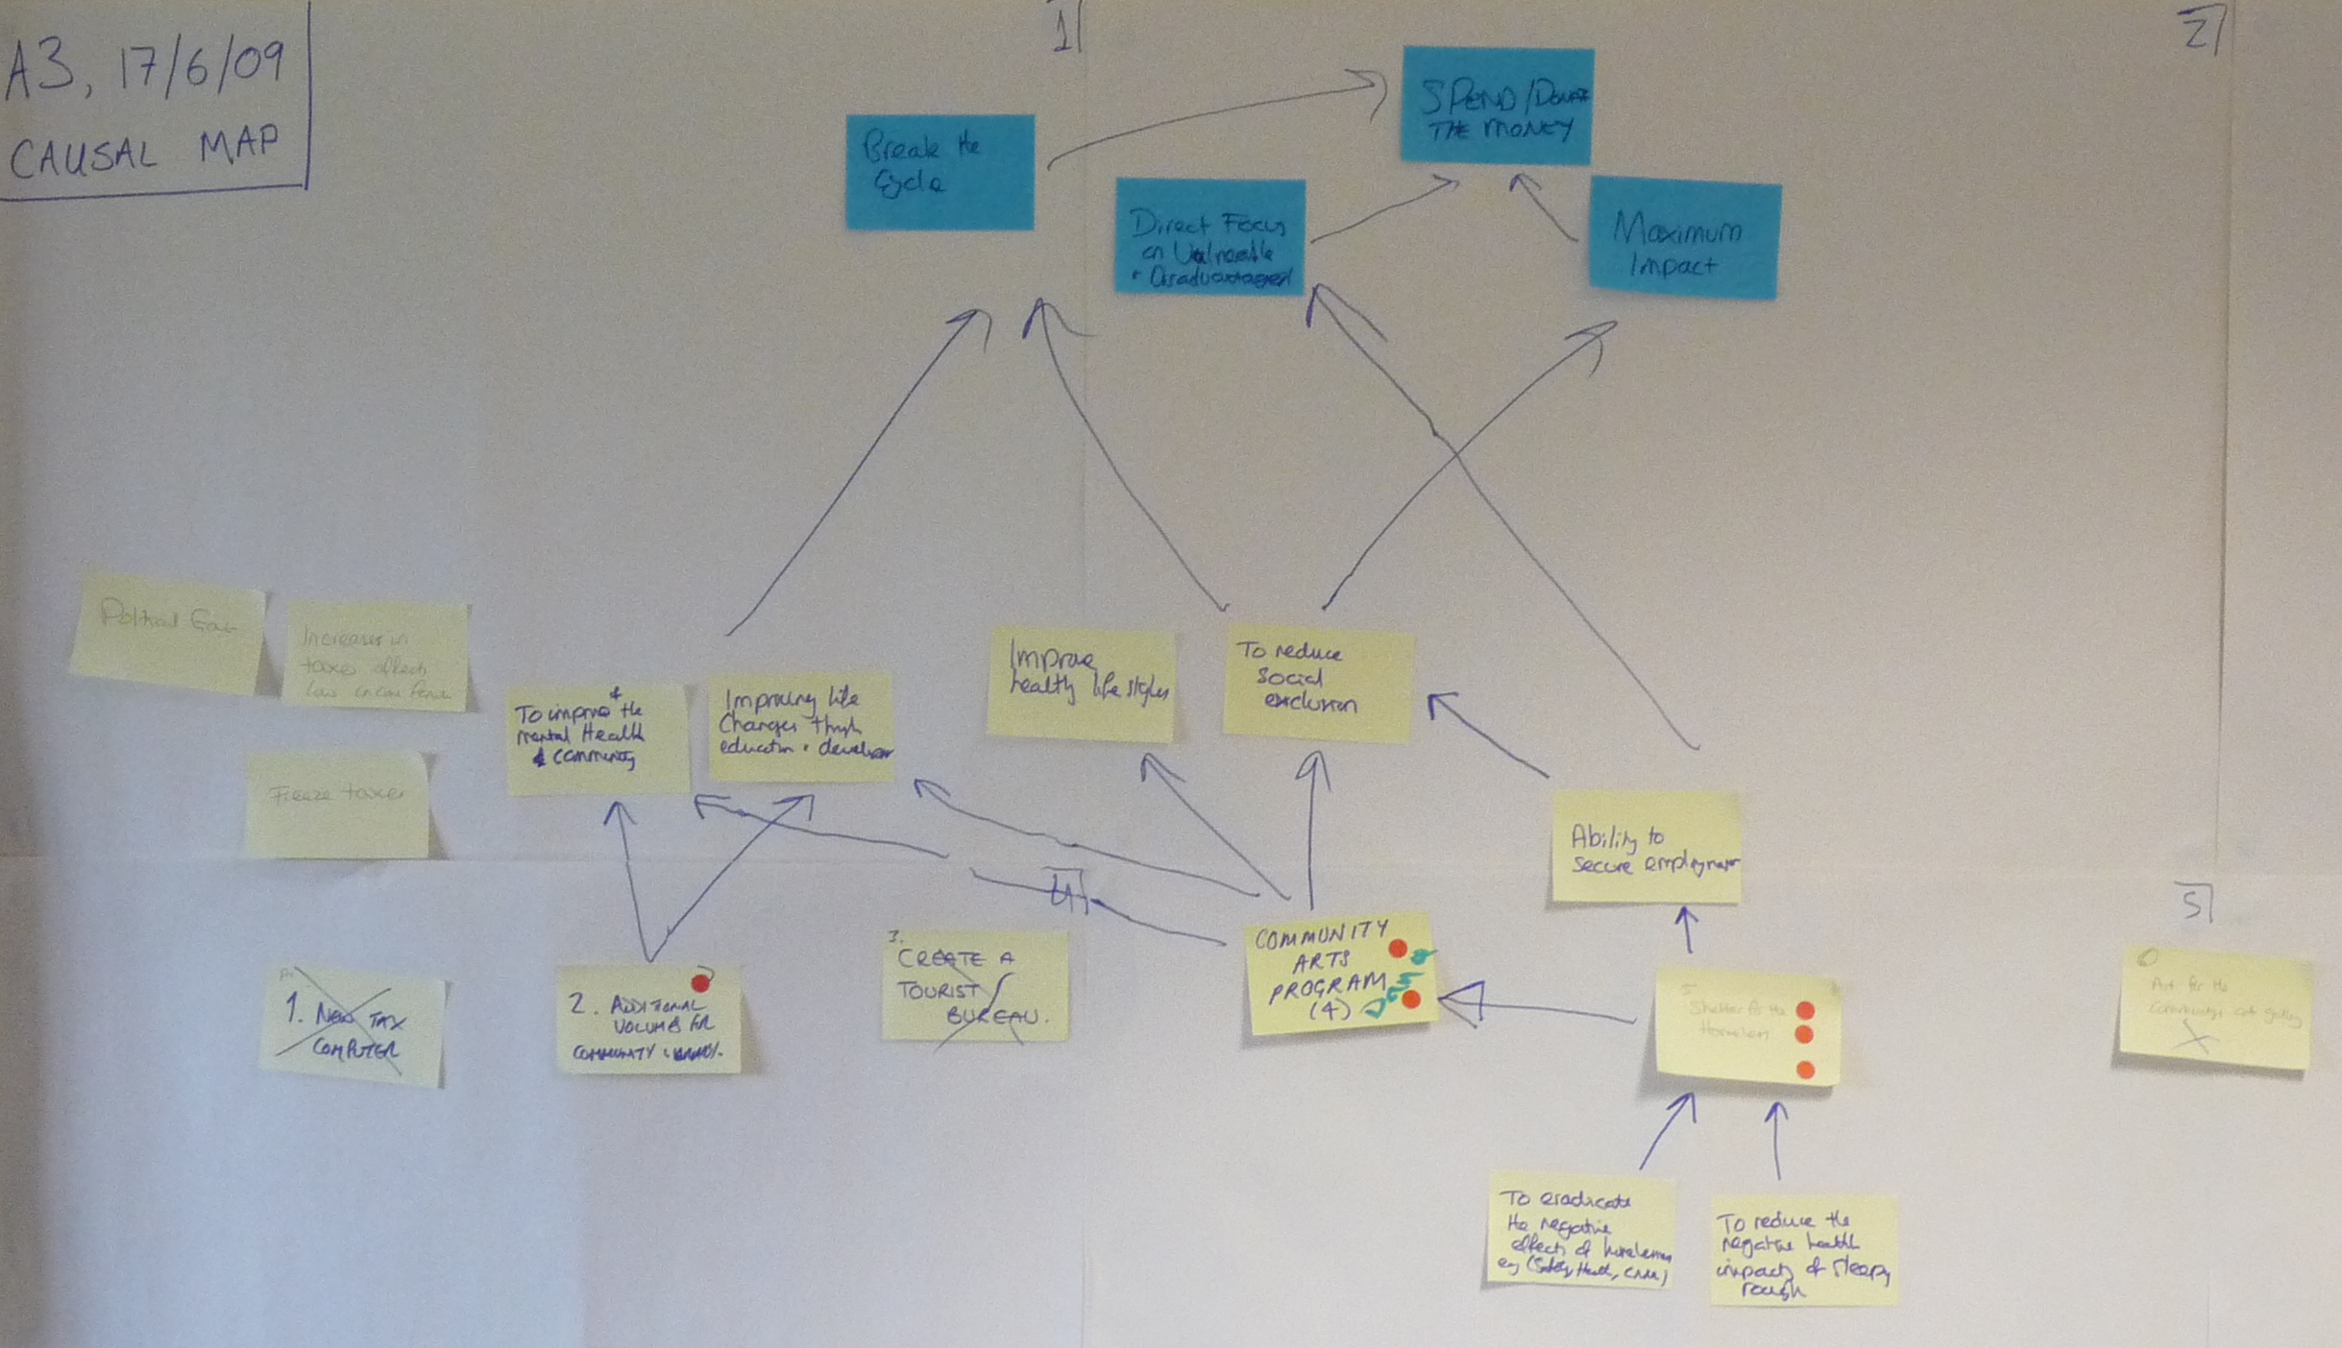
Example means-ends objectives map

Slide 7
Variable construction
Need for closure: scale Webster and Kruglanski (1994)
Conflict management: based on Group Working Relationships Coding Scheme (Poole, 1983; Poole and Roth, 1983)
Units are 30 seconds of interaction
Codes interaction as focused work (FW), critical work (CW), opposition (OPP), capitulation (CAP), tabling (TAB), open discussion (OD) or integration (INT)
Quality of group outcomes:
Consensus: measured on the basis of money assigned to projects (Spillman, Spillman and Bezdek, 1980), pre-meeting (existing conflict) and post-meeting
Satisfaction: (five items on a five point scale, Green and Taber, 1980, alpha = .73)
Group behavior: (eight items on a seven point scale, Gouran, Brown and Henry, 1978, alpha = .84)
Decision quality: (eight items on a seven point scale, Brown and Henry, 1978, alpha = .84)

Slide 8
Speaker | Transcript | Unit | Code
3 | and let's do the system off the other four | 6a | FW
3 | [to assistant: we weren't thinking of switching it off, actually] | 6b | INT
3 | [to assistant: "cut"]
3 | So, okay, so we're going to delete one and two | 6c | FW
2 | One, because two, we're saying it's not belonging to the county system
1 | So you guys-
3 | Cause I don't think, I don't think we are, I think we are saying- | 6d | OPP
2 | Well if two of us interpreted it in the same way, just-
3 | In London there'd be no such thing
2 | Forget London, the rest of the world isn't London, (3:24) little villages, it's rural deprivation | 7 | OPP
3 | I think we just need to step back for a minute and look at the objective here [pointing at case] and I think the inference there, albeit, with semantics around language, is that that is a local authority responsibility
2 | Why are you - that's for us to decide, we can give money to the county if we wanted to, but that's not what we're saying, are we
3 | I'm saying
(Excerpt group C3)

Slide 9
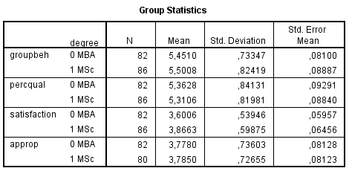
Analysis
Multilevel analysis with three levels:
Individual
conflict management (units or episodes), cohorts
NFC, study type (MBA versus MSc)
Cohorts: some effects, but no consistent increases in for instance satisfaction
MBA versus MSc
MBA groups score lower on NFC (chi-square = 29.79, p < .001)
MSc more satisfied, no effect on other measures group outcome quality

Slide 10
Results
How does NFC influence conflict management in a model-supported group process?
Low NFC groups have more opposition (r = -.353, p < 0.01)
More tabulation (r = -.323, p < 0.01)
More capitulation (r = -.214, p = .006)
More open discussion (r = -.301, p < 0.01)
 | Low NFC | High NFC
Opposition | 11.11 (10.01) | 5.14 (4.98)
Tabulation | 1.47 (1.12) | 0.67 (0.80)
Capitulation | 1.26 (1.24) | 0.62 (0.59)
Open discussion | 7.89 (9.34) | 2.81 (4.29)
(Number of units, cells contain mean and SD, n = 40 groups)

Slide 11
Results
2. How does NFC influence quality of group outcomes?
Consensus: all groups increase in consensus, no effect of NFC (change in consensus high NFC groups (M = 0.22, SD = 0.12) versus low NFC groups (M = 0.18, SD = 0.16, p = 0.41)
Satisfaction: high NFC groups (M = 3.85, SD = 0.80) more than low NFC groups (M = 3.56, SD = 0.57, p < 0.001)
Group behavior: no difference high NFC groups (M = 5.57, SD = 0.77) versus low NFC groups (M = 5.39, SD = 0.81, p = 0.13)
Decision quality: no difference high NFC groups (M = 5.41, SD = 0.80) versus low NFC groups (M = 5.26, SD = 0.86, p = 0.13)

Slide 12
Results
3. How does conflict management influence the relation between NFC and quality of group outcomes?
Controlling for conflict management episodes (level 2) does not increase explained variance, compared to models that only use NFC
Based on comparison of initial random intercepts model with independent variables individual NFC (level 1) and cohorts (level 2) to model with conflict management episodes added

Slide 13
Conclusions
All groups increase in consensus
groups supported by Value Focused Thinking are similar to groups using Electronic Meeting Systems in terms of consensus and conflict management
Need for closure seems to have an effect on conflict management: low NFC groups show more conflict than high NFC groups
… and high NFC groups are more satisfied
Neither NFC nor conflict management seem to be related to consensus, group behavior and decision quality
Two different paths to consensus?

